Slide 1
CSE 105 – Structure Programming
Topic:
if, if-else statement,
Arithmetic Operation

Slide 2
The if Selection Statement
Selection structure:
Used to choose among alternative courses of action
Pseudocode:
If your grade is greater than or equal to 60 Print “Passed”
Pseudocode statement in C:
if ( grade >= 60 ) printf( "Passed\n" );
C code corresponds closely to the Pseudocode/Flowchart

Slide 3
The if Selection Flowchart
if statement is a single-entry/single-exit structure
A decision can be made on any expression.
zero - false
nonzero - true
Example:
3 - 4 is true
true
grade >= 60
print “Passed”
false

Slide 4
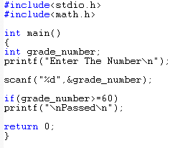



The if Selection Flowchart
if statement is a single-entry/single-exit structure
true
grade >= 60
print “Passed”
false

Slide 5
The if…else Selection Statement
if
Only performs an action if the condition is true
if…else
Specifies an action to be performed both when the condition is true and when it is false
Psuedocode:
If student’s grade is greater than or equal to 60 Print “Passed”
else Print “Failed”
Note spacing/indentation conventions

Slide 6



The if…else Selection Statement
Flowchart of the if…else selection statement
false
true
grade >= 60
print“Failed”
print“Passed”

Slide 7
Compound Statements
In the if statement template, notice that statement is singular, not plural:
if ( expression ) statement
To make an if statement control two or more statements, use a compound statement.
false
true
grade >= 60
print“Sorry”
print“Failed”
print“Congratulation”
print“Passed”
A compound statement has the form
{
Statement 1;
Statement 2;
Statement 3;
}
Putting braces around a group of statements forces the compiler to treat it as a single statement.

Slide 8
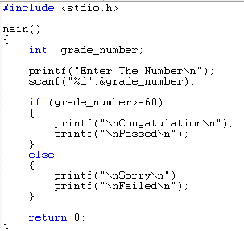
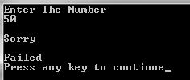

Compound Statements
false
true
grade >= 60
print“Sorry”
print“Failed”
print“Congratulation”
print“Passed”

Slide 9
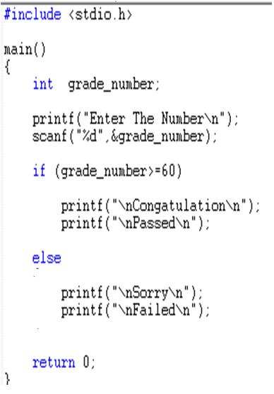

Compound Statements
false
true
grade >= 60
print“Sorry”
print“Failed”
print“Congratulation”
print“Passed”

Slide 10
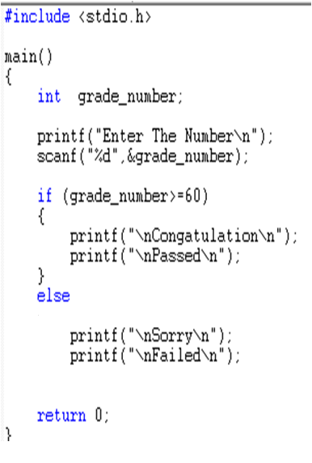

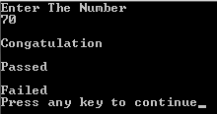
Compound Statements
false
true
grade >= 60
print“Sorry”
print“Failed”
print“Congratulation”
print“Passed”
That is Whatever the Value of GRADE
It Always Execute the Failed Statements

Slide 11
Compound Statements
Example:
{ line_num = 0; page_num++; }
A compound statement is usually put on multiple lines, with one statement per line:
{
line_num = 0;
page_num++;
}
Each inner statement still ends with a semicolon, but the compound statement itself does not.

Slide 12
Compound Statements
Example of a compound statement used inside an if statement:
if (line_num == 15) {
line_num = 0;
page_num++;
}
Compound statements are also common in loops and other places where the syntax of C requires a single statement.

Slide 13
Relational Operators
C’s relational operators:
< less than
> greater than
<= less than or equal to
>= greater than or equal to
These operators produce 0 (false) or 1 (true) when used in expressions.
The relational operators can be used to compare integers and floating-point numbers, with operands of mixed types allowed.

Slide 14
Equality Operators
C provides two equality operators:
== equal to
!= not equal to
The equality operators produce either 0 (false) or 1 (true) as their result.

Slide 15
Arithmetic Operators
Addition + sum = num1 + num2;
Subtraction - age = 2007 – my_birth_year;
Multiplication * area = side1 * side2;
Division / avg = total / number;
Modulus % lastdigit = num % 10;
Modulus returns remainder of division between two integers
Example 5%2 returns a value of 1
Binary vs. Unary operators
All the above operators are binary (why)
- is an unary operator, e.g., a = -3 * -4

Slide 16
Arithmetic Operators (cont’d)
Note that ‘id = exp‘ means assign the result of exp to id, so
X=X+1 means
first perform X+1 and
Assign the result to X
Suppose X is 4, and
We execute X=X+1
4
5
X

Slide 17
Integer division vs Real division
Division between two integers results in an integer.
The result is truncated, not rounded
Example:
int A=5/3; → A will have the value of 1
int B=3/6; → B will have the value of 0
To have floating point values:
double A=5.0/3; → A will have the value of 1.666
double B=3.0/6.0; → B will have the value of 0.5

Slide 18
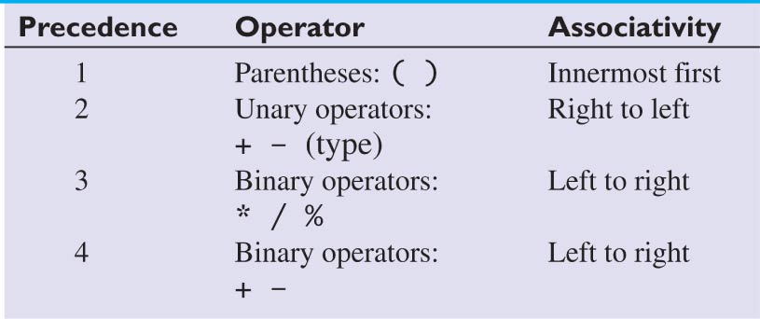
Precedence of Arithmetic Operators
Mixed operations:
int a=4+6/3*2; → a=?
int b=(4+6)/3*2; → b=?
a= 4+2*2 = 4+4 = 8
b= 10/3*2 = 3*2= 6
5 assign = Right to left

Slide 19
Exercise
Compute the following
2*(3+2)
2*3+2
6-3*2

Slide 20
Exercise
Write a C statement to compute the following
f = (x*x*x-2*x*x+x-6.3)/(x*x+0.05*x+3.14);
Write a C statement to compute the following
Tension = 2*m1*m2 / m1 + m2 * g;
wrong
Tension = 2*m1*m2 / (m1 + m2) * g

Slide 21
Exercise: swap
Write a set of statements that swaps the contents of variables x and y
3
5
5
3
x
y
x
y
Before
After

Slide 22
Exercise: swap
First Attempt
x=y;
y=x;
3
5
5
5
5
5
x
y
x
y
x
y
Before
After x=y
After y=x

Slide 23
Exercise: swap
Solution
temp= x;
x=y;
y=temp;
3
5
?
3
5
3
5
5
3
5
3
3
x
y
temp
x
y
temp
x
y
temp
x
y
temp
Before
after temp=x
after x=y
after y = temp
Can you do it without using temp?
i.e., without using any extra variable ?

Slide 24
Exercise: reverse a number
Suppose you are given a number in the range [100 to 999]
Write a program to reverse it
For example,
num is 258
reverse is 852
We Can do it using % operators, try 5 mins.
Ans the Q 1. What is the result of num/10 and num %10?
2. How many digits ?
3. What will be the next steps ?

Slide 25
Exercise: Arithmetic operations
Show the memory snapshot after the following operations by hand
int a, b, c=7;
double x, y;
a = c * 2.5;
b = a % c * 2 - 1;
x = (5 + c) * 2.5;
y = x – (-3 * a) / 2;
Write a C program and print out the values of a, b, c, x, y and compare them with the ones that you determined by hand.
?
?
5
?
?
a
b
c
x
y
Fill the table, try 5 mins.
a = 17 b = 5 c= 5 x = 30.0000 y = 55.0000

Slide 26
Exercise: Arithmetic operations
Show how C will perform the following statements and what will be the final output?
int a = 6, b = -3, c = 2;
c = a - b * (a + c * 2) + a / 2 * b;
printf("Value of c = %d \n", c);
c = 6 - -3 * (6 + 2 * 2) + 6 / 2 * -3;
c = 6 - -3 * (6 + 4) + 3 * -3
c = 6 - -3 *10 + -9
c = 6 - -30 + -9
c = 36 + -9
c = 27

Slide 27
Math Functions
#include <math.h>
fabs(x) Absolute value of x.
sqrt(x) Square root of x, where x>=0.
pow(x,y) Exponentiation, x^{y}. Errors occur if
x=0 and y<=0, or if x<0 and y is not an integer.
ceil(x) Rounds x to the nearest integer toward ∞ (infinity).
Example, ceil(2.01) is equal to 3.
floor(x) Rounds x to the nearest integer toward -∞ (negative infinity). Example, floor(2.01) is equal to 2.
exp(x) Computes the value of e^{x}.
log(x) Returns ln x, the natural logarithm of x to the base e. Errors occur if x<=0.
log10(x) Returns log10x, logarithm of x to the base 10.
Errors occur if x<=0.

Slide 28
Trigonometric Functions
sin(x) Computes the sine of x, where x is in radians.
cos(x) Computes the cosine of x, where x is in radians
tan(x) Computes the tangent of x, where x is in radians.
asin(x) Computes the arcsine or inverse sine of x,
where x must be in the range [-1, 1].
Returns an angle in radians in the range [-π/2,π/2].
acos(x) Computes the arccosine or inverse cosine of x,
where x must be in the range [-1, 1].
Returns an angle in radians in the range [0, π].
atan(x) Computes the arctangent or inverse tangent of x. The Returns an angle in radians in the range [-π/2,π/2].
atan2(y,x) Computes the arctangent or inverse tangent of the value y/x. Returns an angle in radians in the range [-π, π].

Slide 29
Exercise
Write an expression to compute velocity using the following equation
Assume that the variables are declared
velocity = sqrt(vo*vo+2*a*(x-xo));

Slide 30
Exercise
Write an expression to compute velocity using the following equation
Assume that the variables are declared
center = (38.19*(pow(r,3)-pow(s,3))*sin(a))/
((pow(r,2)-pow(s,2))*a);

Slide 31
Exercise: Compute Volume
Write a program to compute the volume of a cylinder of radius r and height h
r
h

Slide 32
Exercise
Write a program to find the radius of a circle given its area. Read area from user. Compute radius and display it.
r

Slide 33

Questions or Suggestions

Slide 34

Thank You!

